Slide 1
Transfer data from Local MySQL data to AWS Glue
Using
Connections & Connectors

Slide 2
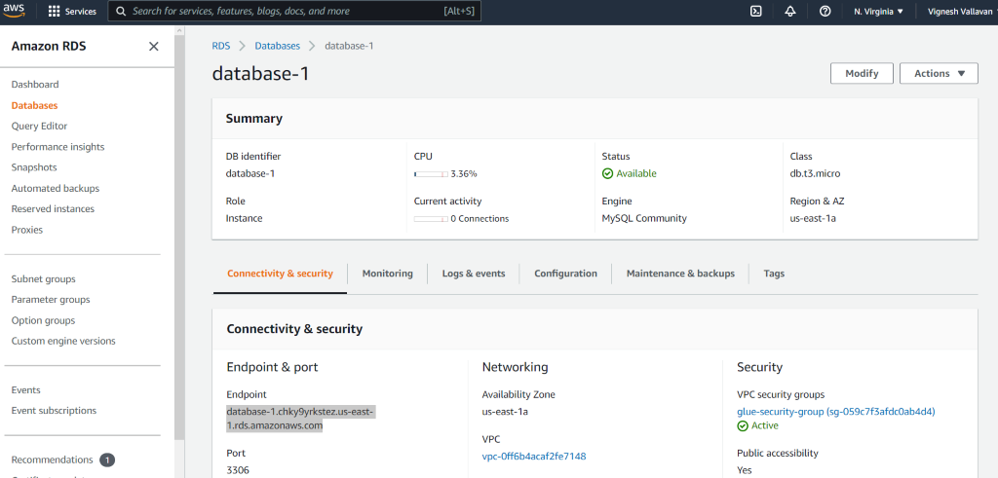
1. RDS setup in local MYSQL database https://youtu.be/Ng_zi11N4_c
2. RDS – JDBC Connection https://youtu.be/UUoQAe_NzaA
1. Create RDS
While creating RDS, remember username and password
Copy Endpoint name and paste it in to the hostname in local MySQL workbench

Slide 3
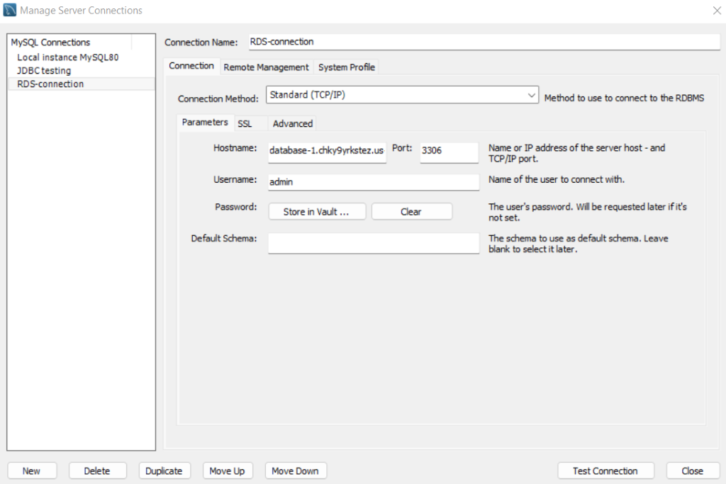
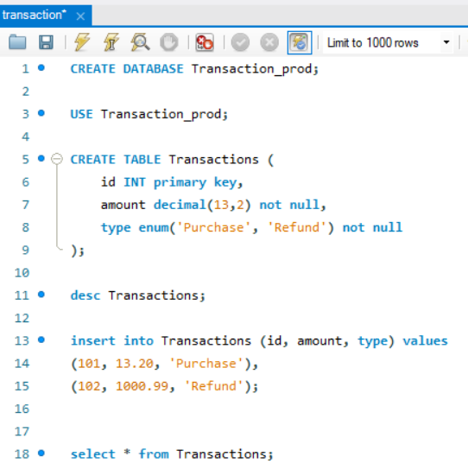
Local MySQL server connection Window
Test connection: If it returns an error--> Please change Security Groups in RDS
If it returns successfully, then starts SQL query

Slide 4
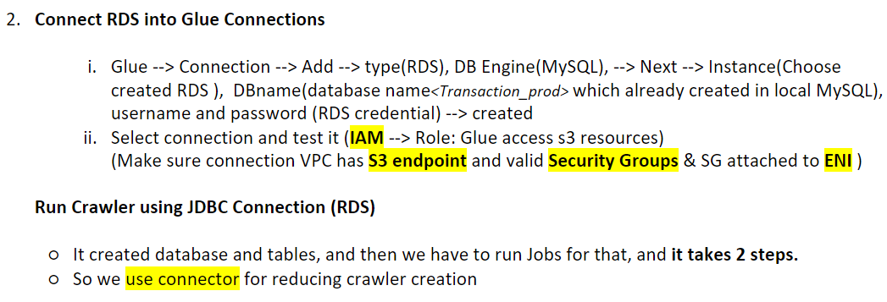

Slide 5
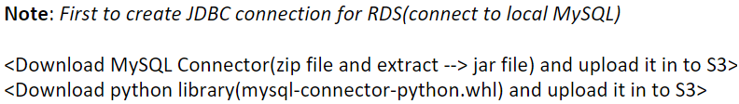
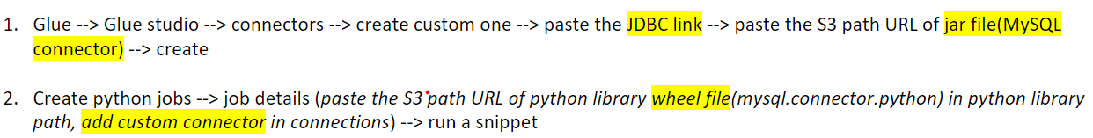
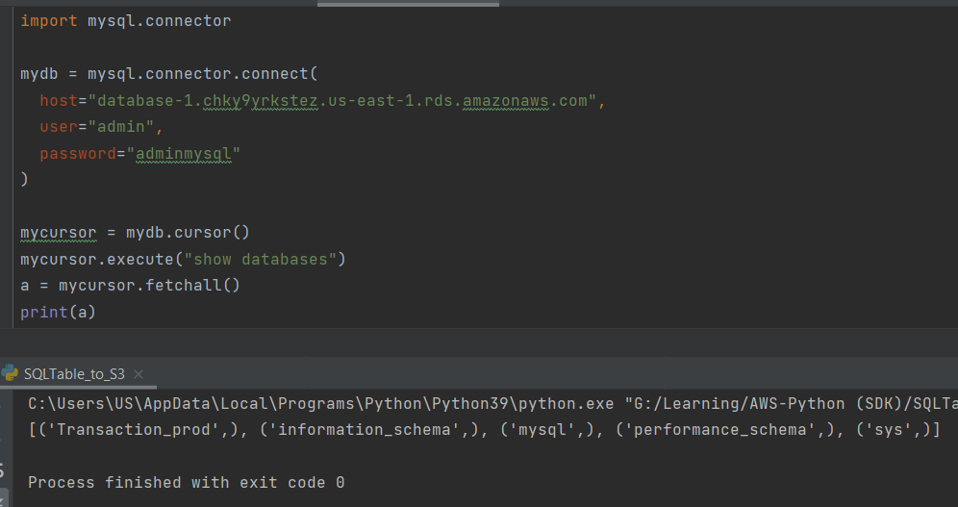
Connectors:
https://dev.mysql.com/downloads/connector/j/
https://pypi.org/project/mysql-connector-python/
In snippet, host = "<RDS Endpoint name>"

